Slide 1



Slide 2
About today…
Centralized State Management
Brief overview of Redux
Why Redux is used with React
Why Redux is used with React

Slide 3
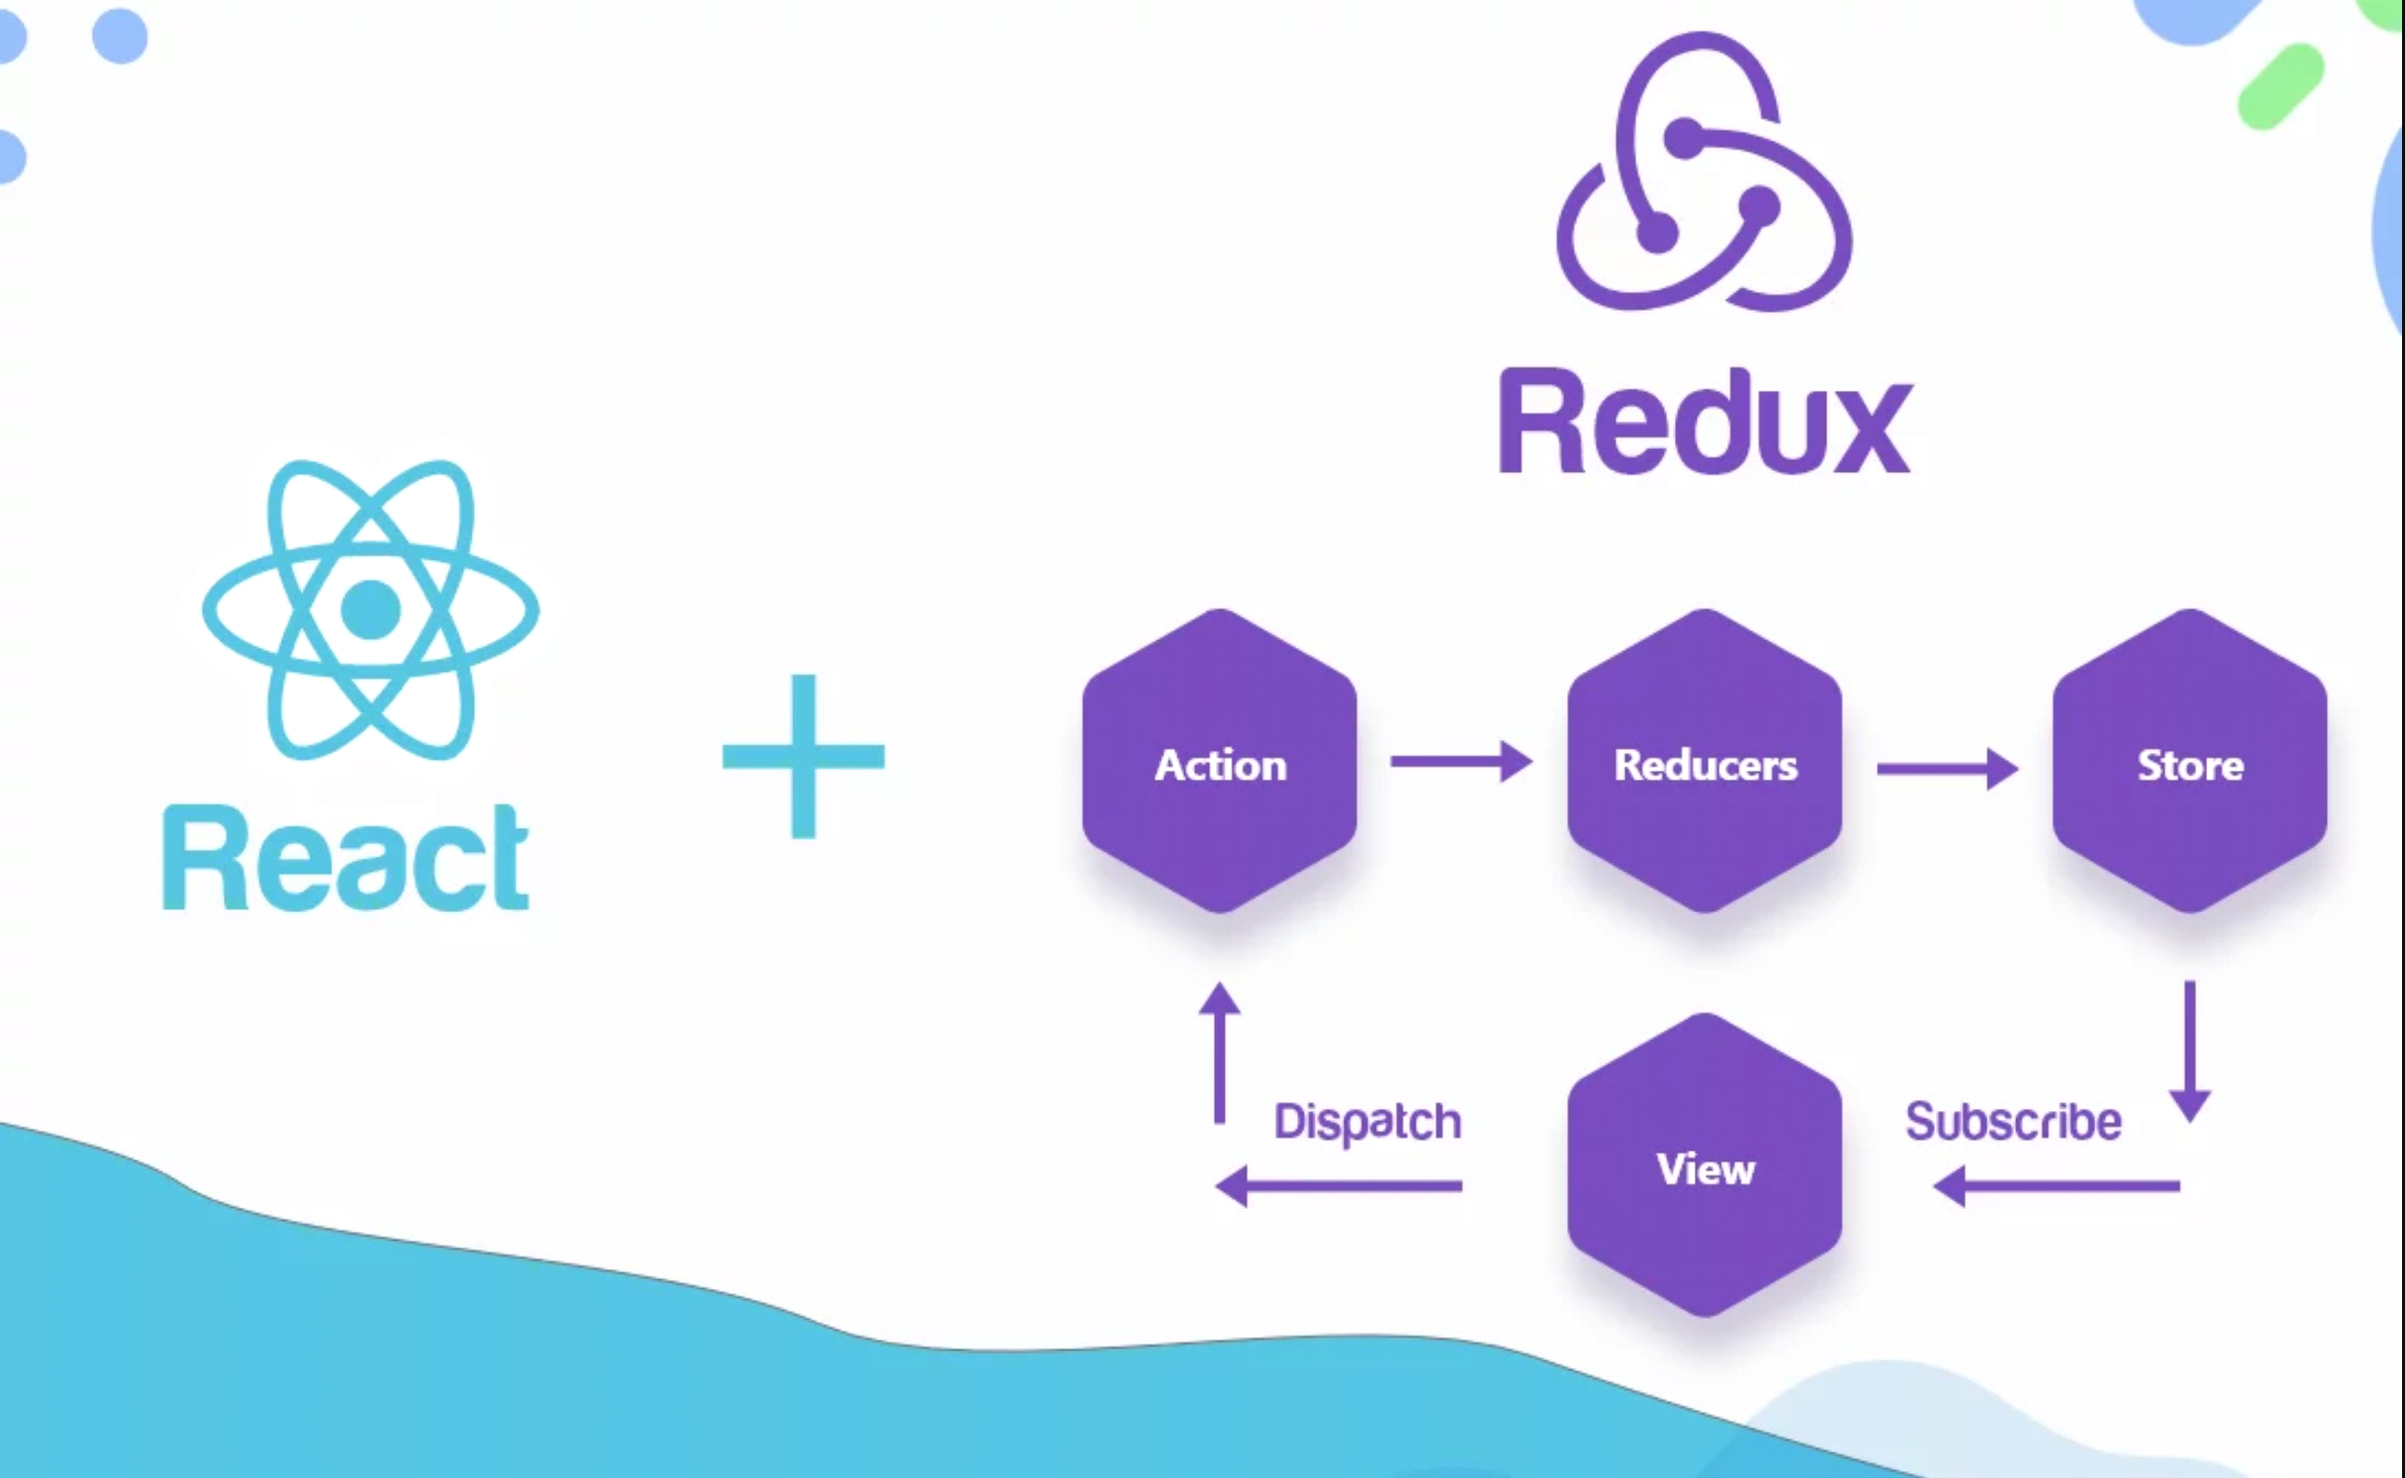

Slide 4
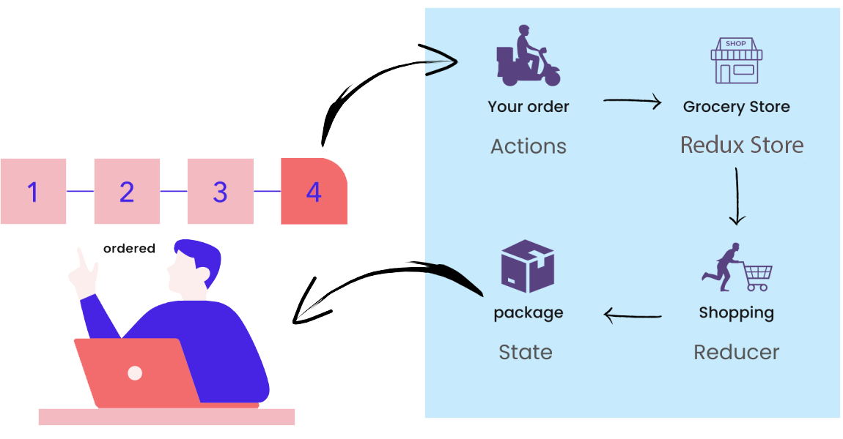
What is Redux?
Definition
Redux is a state management library for JavaScript applications
Purpose
Manages application state in a predictable way
Helps with debugging and testing
Components
Store
Actions
Reducers
Middleware

Slide 5

Why Use Redux with React?
State Management
React’s local state can become complex as applications grow
Predictability
Redux provides a single source of truth (the store)
Debugging
Tools like Redux DevTools make it easier to track state changes
Separation of Concerns
Separates state management from UI components

Slide 6
Core Concepts of Redux
Actions
Store
Plain JavaScript objects that describe what happened
Holds the application state
Created using createStore() from Redux
Example:
{ type: 'ADD_ITEM', payload: 'New Item' }
Reducers
Middleware
Functions that specify how the state changes in response to actions
Plain JavaScript objects that describe what happened
Pure functions that take state and action as arguments
Example:
{ type: 'ADD_ITEM', payload: 'New Item' }

Slide 7
When to Use Redux?
Complex State Management
When your application state becomes too complex for React’s local state
Shared State
When multiple components need to share or access the same state
Predictability
When you need predictable state changes for easier debugging
Testing
When you need to test state management logic separately from UI components

Slide 8
How Redux Works
Flow of Data
Action
Describes what happened
Reducer
Processes the action and updates the state
Store
Holds the updated state and provides it to components

Slide 9

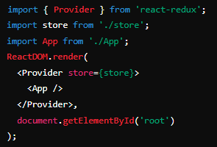

Setting Up Redux with React
Installation
Provide Store
Create Store
Wrap your app with the <Provider> component from react-redux
Import createStore and your root reducer

Slide 10


Creating Actions
Action Creators
Functions that create and return action objects
Action Types
Define action types as constants to avoid typos

Slide 11
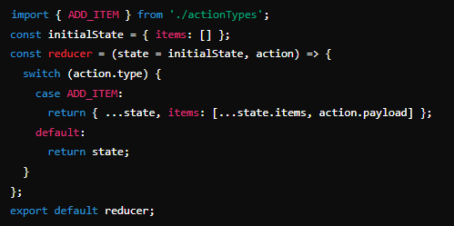
Creating Reducers
Reducer Function
Takes the current state and an action, and returns a new state

Slide 12
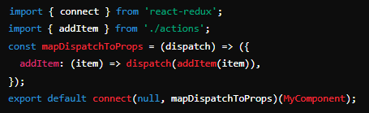
Connecting Redux with React
connect Function
Takes the current state and an action, and returns a new state

Slide 13
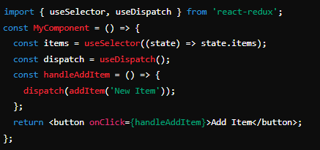
Connecting Redux with React
‘useSelector’ and ‘useDispatch’ Hooks
Hooks for accessing Redux state and dispatching actions

Slide 14

What is the primary purpose of Redux in a React application?
To manage application state in a predictable way
Name the three core principles of Redux
Single source of truth (the store)
State is read-only
Changes are made with pure functions (reducers)
What does an action in Redux typically consist of?
An action typically consists of a type and optionally a payload
How does a reducer function operate?
A reducer takes the current state and an action as arguments and returns a new state
Why should action types be defined as constants?
To avoid typos and ensure consistency across the application

Slide 15


Slide 16

Task
Set up a basic Redux environment in a Counter React application and manage a simple state

